Slide 1
CMR College of Engineering & Technology
(UGC Autonomous)
Accredited by NAAC with “A” Grade
Kandlakoya, Medchal Road, Hyderabad-501401
Department of Computer Science & Engineering
PLAGIARISM DETECTION OF IMAGES
Guide Name:
Mr. Mohd Abdul Rahaman
(Assistant Professor)
Batch Number 87
Roll Numbers: Name
19H51A0511 J Sai Rakesh
19H51A0518 N Narasimha
19H51A05B1 M Abhishek
CMRCET - CSE

Slide 2
Contents
Abstract
Literature Review
Existing Works
Results of Existing System
Proposed System
Implementation

Slide 3
Abstract
Plagiarism is when someone takes another author’s works, thoughts, ideas, etc. without proper referencing and claim it as his/her own works.
Plagiarism detection is the process to find the plagiarism within a work or documents.
With the advance of modern technology, it makes it easier for people to search for information and plagiarize the work of others.
It consists three stages: the pre-processing, feature extraction and comparison stage.
The results showed in an ascending order of similarity index and true and false.
the accuracy is 100% in case of unedited images and variated in other operations such as flipped, rotated, greyscales and cropped.
CMRCET-CSE

Slide 4
Literature Review
S.No | Author | Title of the paper | Year | Inference
1 | AC Popescu and H Farid | Exposing Digital Forgeries by Detecting Duplicated Image Regions | 2004 | an efficient technique that automatically detects duplicated regions in a digital image
2 | Vinod K.R.*, Sandhya.S, Vinod K.R.*, Sandhya.S, Sandhya.S,SathishKumar D | Plagiarism- history, detection and prevention | 2011 | It describes history of the plagiarism and detection of plagiarism

Slide 5
Existing Works
Principal Part Analysis
Method by Popescu and Farid proposed a system by using the Principal Part Analysis (PCA). This system divides the numerous tiny sized blocks into vectors which is then organized lexicographically before matching them.
Disadvantage
The main drawback for this system is that if the image quality is too low then the accuracy will fall as well.
CMRCET-CSE
Notes:
CMRCET-CSE

Slide 6
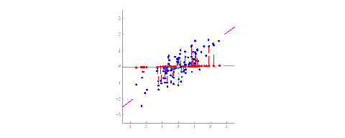
If we have two columns representing the X and Y columns, you can represent it in a 2D axis. Let’s say we add another dimension i.e., the Z-Axis, now we have something called a hyperplane representing the space of an 3D image.
The idea of PCA is to re-align the axis in an n-dimensional space such that we can capture most of the variance in the data. In the industry, features that do not have much variance are discarded as they do not contribute much to any machine learning model. These new axes that represent most of the variance in the data is know as principle components

Slide 7
BLUR MOVEMENT
Mahdian and Saic apply a blur movement variant to signify the image region so that the images will not be degraded from blurring and noises. This system begins by tilting the image with selected size blocks and defined it with blur invariants.
Disadvantage
The drawback from this method is that the computation time for this system is very long.

Slide 8

Iris biometric for personal identification is based on capturing an eye image and obtaining features that will help in identifying a human being. However, captured images may not be of good quality due to variety of reasons e.g. occlusion, blurred images etc. Thus, it is important to assess image quality before applying feature extraction algorithm.

Slide 9

Copy Move Plagiarism
An experiment conducted by Wang et al used a copy-move plagiarism detection system by applying the victimization Hu moments to cut down the computation time of the system.
This system divides the image into numerous sized blocks and then applying the Hu moments on the block they computed the Eigen value

Slide 10
Zimba and Xingming for the copy-move detection system. The system starts by converting the image into a gray scale image and then applying DWT.
The image is then divided into overlapping blocks and then PCA is done to each block. This method cuts down the computation time of the system compare to the PCA method by reducing the size of the image.
Bravo-Solorio and Nandi proposed a system to detect reflection, scaling and rotation of an images. The drawback is that their methods produced a lot of matches which needed to be further improve.
A system that had been proposed by Sridevi et al used the copy-move detection system in parallel which makes the system unable to used methods that has a requirement of long computation time.
Disadvantage
The only disadvantage with this system is that it cannot detect colored images. IV. R

Slide 11
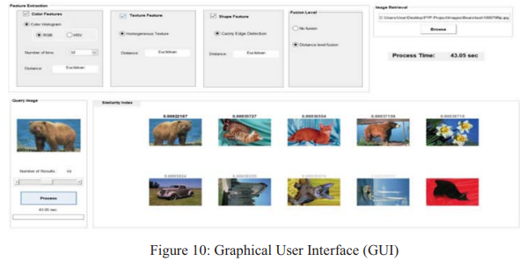
Results of Existing System
CMRCET-CSE

Slide 12
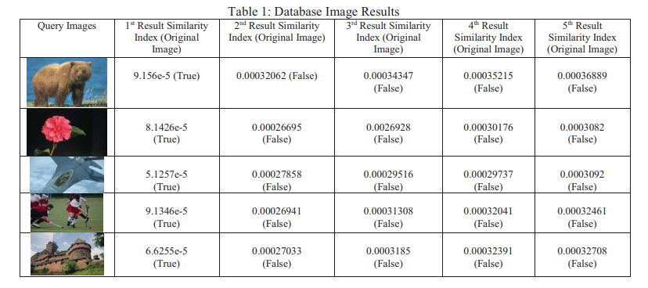
.

Slide 13
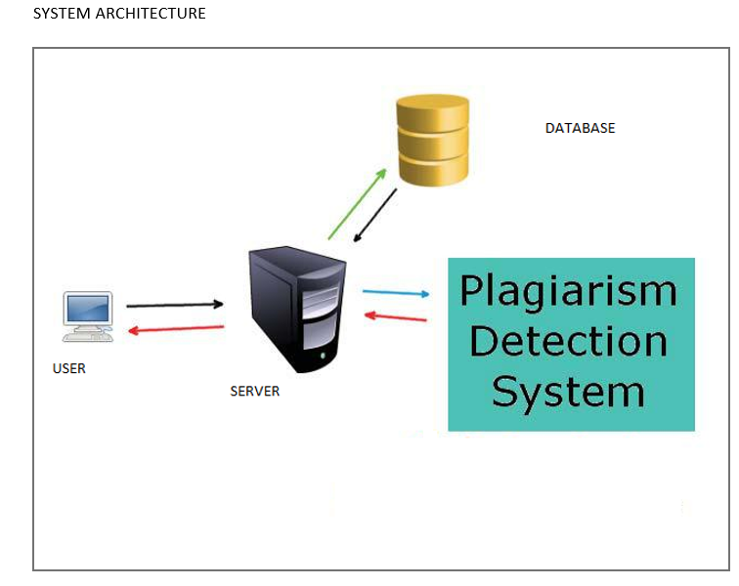
Proposed System
System Architecture
CMRCET-CSE

Slide 14
Algorithm
Canny edge algorithm
The Canny edge detection algorithm is composed of 5 steps:
Noise reduction;
Gradient calculation;
Non-maximum suppression;
Double threshold;
Edge Tracking by Hysteresis.

Slide 15
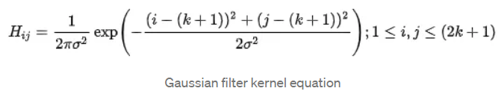
Implementation
Noise Reduction
Since the mathematics involved behind the scene are mainly based on derivatives (cf. Step 2: Gradient calculation), edge detection results are highly sensitive to image noise.
One way to get rid of the noise on the image, is by applying Gaussian blur to smooth it. To do so, image convolution technique is applied with a Gaussian Kernel (3x3, 5x5, 7x7 etc…). The kernel size depends on the expected blurring effect. Basically, the smallest the kernel, the less visible is the blur. In our example, we will use a 5 by 5 Gaussian kernel.
The equation for a Gaussian filter kernel of size (2k+1)×(2k+1) is given by:

Slide 16
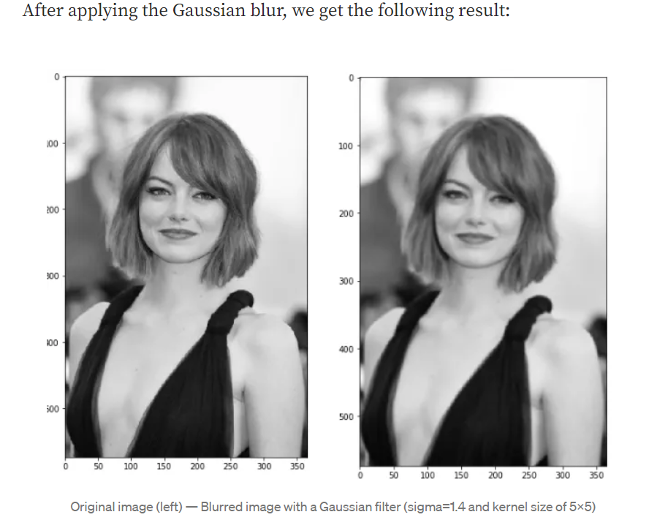
.

Slide 17
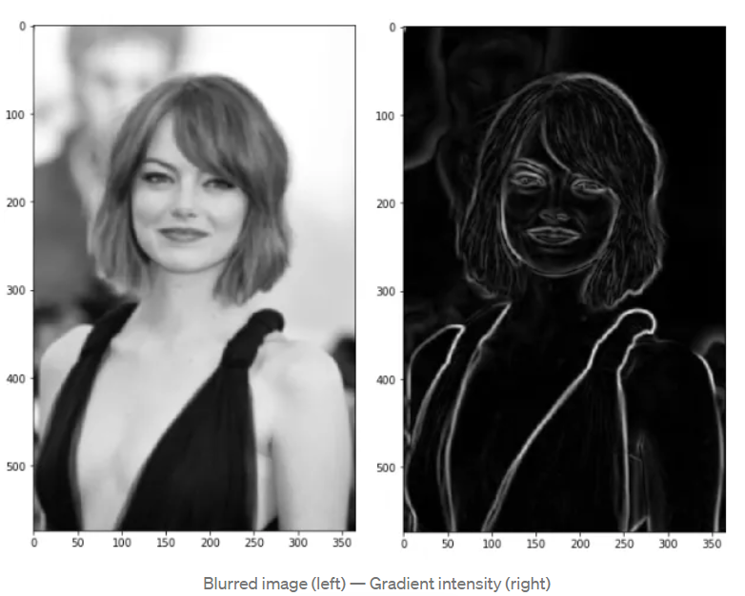
.
Gradient Calculation
The Gradient calculation step detects the edge intensity and direction by calculating the gradient of the image using edge detection operators.
Edges correspond to a change of pixels’ intensity. To detect it, the easiest way is to apply filters that highlight this intensity change in both directions: horizontal (x) and vertical (y)

Slide 18
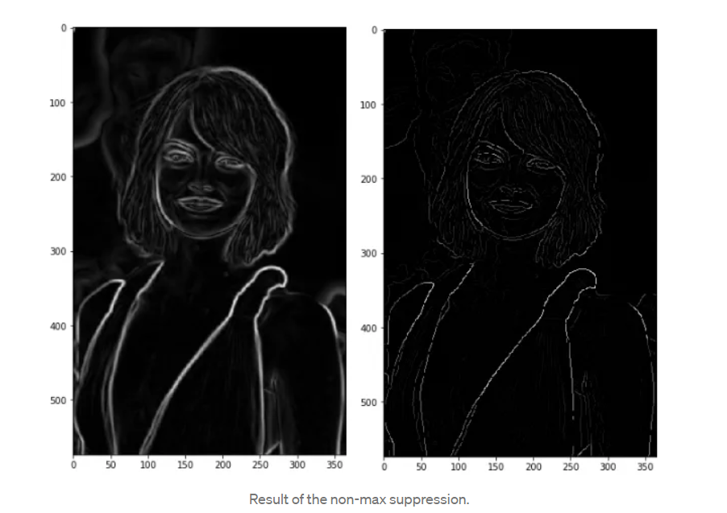
Non-Maximum Suppression
Ideally, the final image should have thin edges. Thus, we must perform non-maximum suppression to thin out the edges.
The principle is simple: the algorithm goes through all the points on the gradient intensity matrix and finds the pixels with the maximum value in the edge directions.

Slide 19
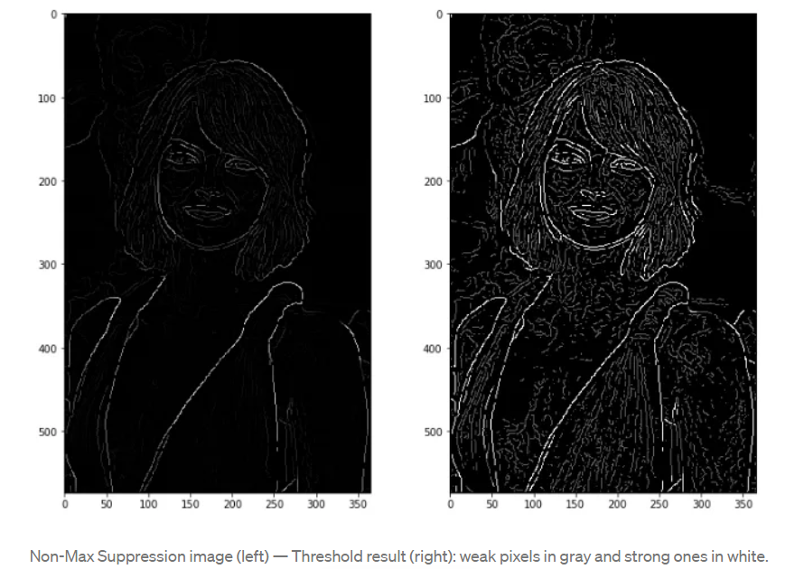
Double threshold
The double threshold step aims at identifying 3 kinds of pixels: strong, weak, and non-relevant:
High threshold is used to identify the strong pixels (intensity higher than the high threshold)
Low threshold is used to identify the non-relevant pixels (intensity lower than the low threshold)
All pixels having intensity between both thresholds are flagged as weak and the Hysteresis mechanism (next step) will help us identify the ones that could be considered as strong and the ones that are considered as non-relevant.

Slide 20
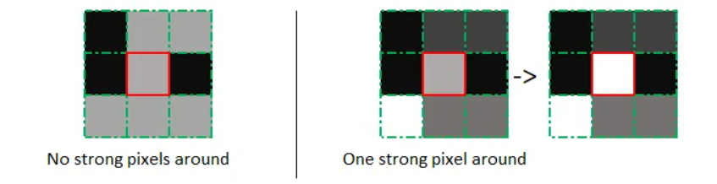
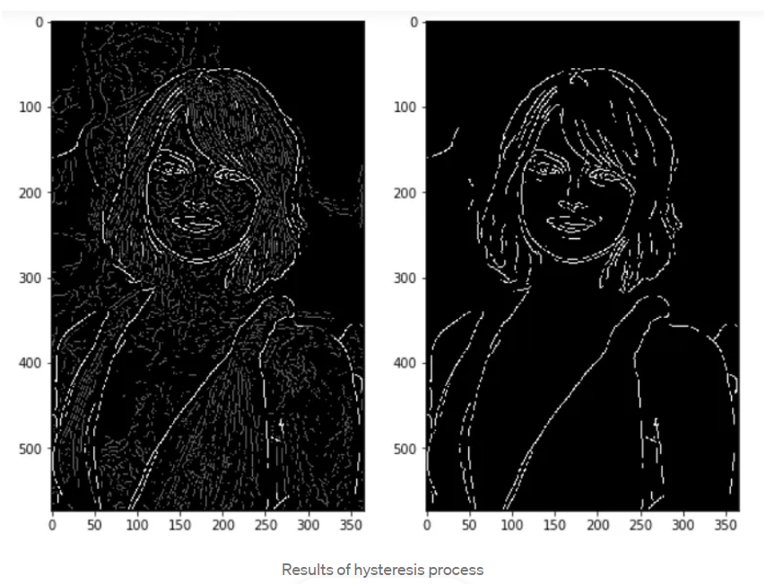
.
Edge Tracking by Hysteresis
Based on the threshold results, the hysteresis consists of transforming weak pixels into strong ones, if and only if at least one of the pixels around the one being processed is a strong one, as described below:

